Slide 1
Design presentation on
Fake Tweet Detection Using Multinomial Naïve Bayes Classifier Algorithm
Group No: CEC/CS/2022/P26
Submitted By :
S SREENIVASA SHENOY (4CB19CS087)
P PADMAPRASAD SHENOY (4CB19CS064)
SUBRAMANYA A SHET (4CB19CS105)
SUHAS S KAMATH (4CB19CS106)
Under the guidance of :
MR. SHATANANDA BHAT P
Assistant Professor

Slide 2
Content
• Abstract
• Modular Design Diagram
• Data Flow Diagram
• Sequence Diagram
• Class Diagram
• Control Flow Design
• Activity Diagram for Use Cases
• Presentation Layer Design
• User Interface Flow Design
• Implementation
• Coding Details and Code Efficiency

Slide 3
Abstract
The proposed system aims to develop a machine-learning model that can detect fake tweets.
This is important because fake tweets can spread misinformation and cause panic.
The dataset used in this study will be a dataset of tweets that have been labelled as fake or not fake.
The machine learning model will be trained on this dataset and then tested on a separate dataset.
The model will be evaluated on its ability to correctly classify fake tweets.

Slide 4
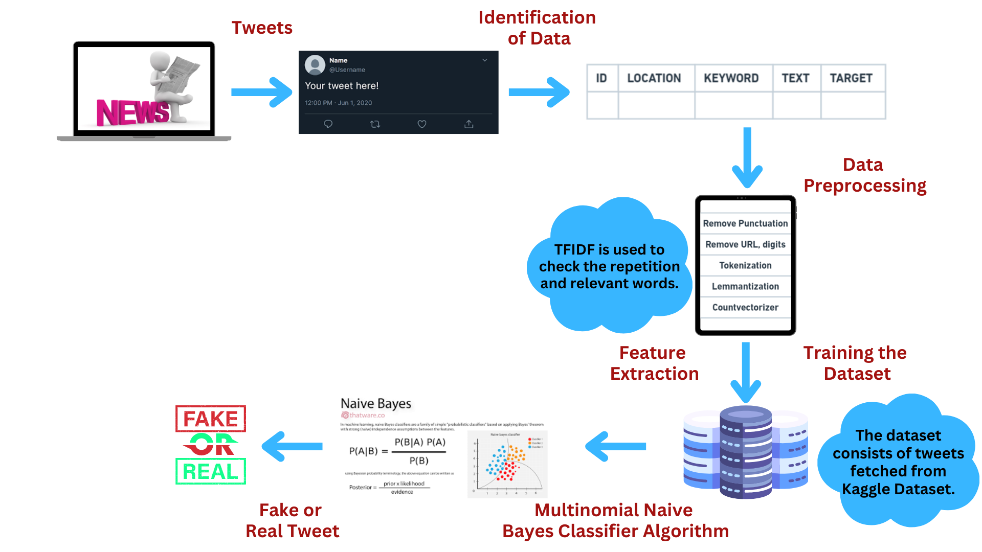
Abstract Design
Architectural Design

Slide 5
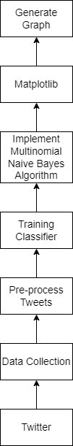
Functional Design
Modular Design

Slide 6
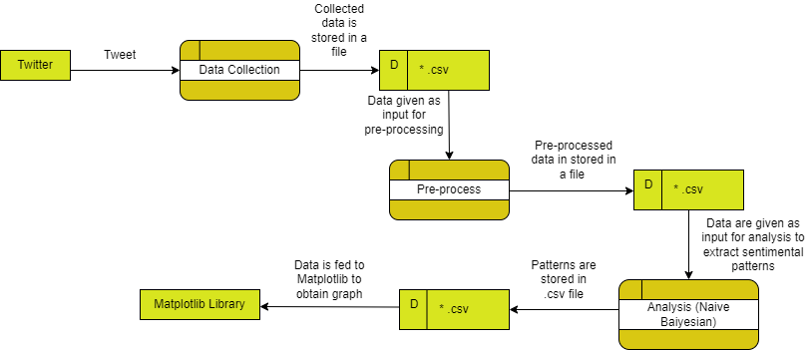
Functional Design
Data Flow Diagram

Slide 7
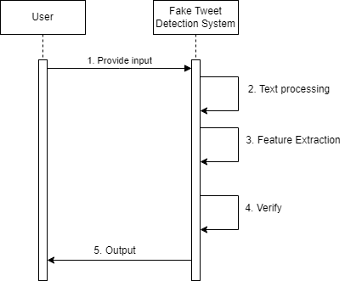
Functional Design
Sequence Diagram

Slide 8
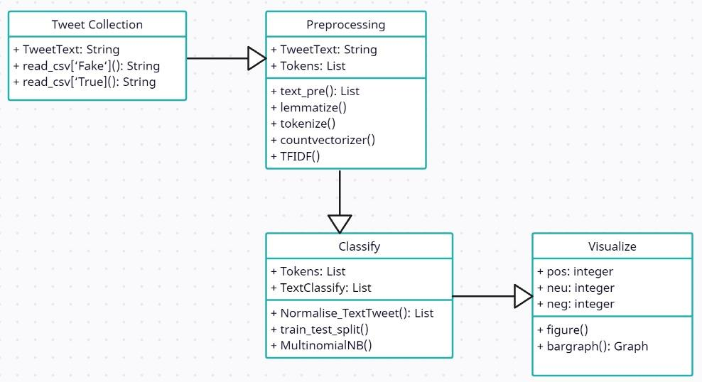
Functional Design
Class Diagram

Slide 9
Control Flow Design
Collect a dataset of tweets that are labeled as either fake or real.
Preprocess the data by removing stop words, stemming and tokenizing the text.
Select the most relevant features using feature selection techniques such as chi-square or mutual information.
Split the dataset into training and testing sets.
Train the Multinomial Naïve Bayes (MNB) classifier algorithm on the training set using the selected features.
Evaluate the performance of the trained model on the testing set using metrics such as accuracy, precision, recall and F1-score.

Slide 10
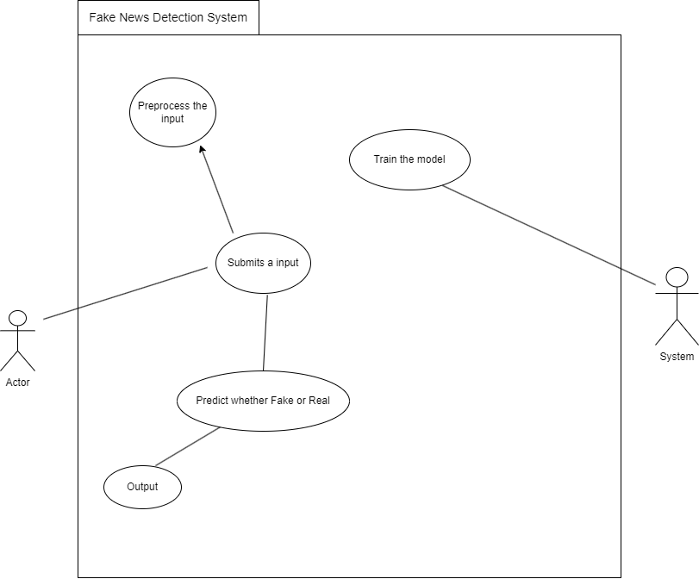
Control Flow Design
Activity diagram
for Use Cases

Slide 11
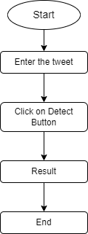
Presentation Layer Design
User Interface Flow Design

Slide 12
Implementation Approaches
Data collection: The first step is to collect a dataset of tweets that are labeled as either fake or real. This dataset should be diverse, balanced, and representative of the problem domain.
Data preprocessing: Once the data is collected, it needs to be preprocessed to convert the raw text into a form that can be used by the MNB classifier algorithm. This involves tasks such as tokenization, stop-word removal, stemming, and feature extraction.
Feature selection: Not all features in the dataset are equally important for classifying tweets as fake or real. Feature selection techniques such as chi-square test or mutual information can be used to identify the most relevant features for classification.
Model training: The next step is to train the MNB classifier algorithm on the preprocessed and selected features. During training, the algorithm learns the probability distribution of the features in the fake and real tweet classes.
Model evaluation: Once the model is trained, it is evaluated on a separate dataset to measure its performance.

Slide 13
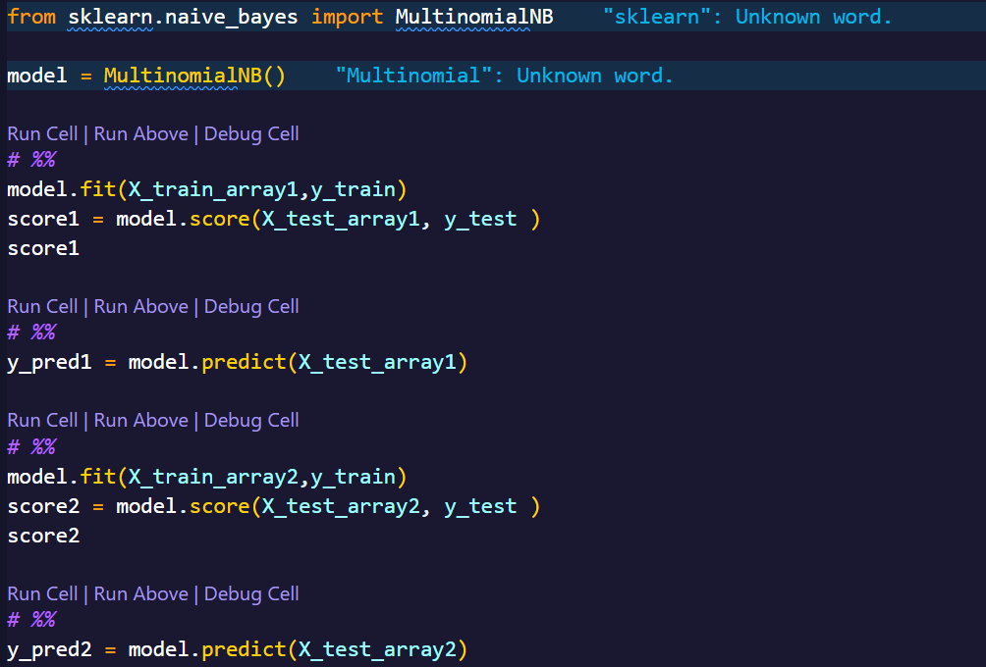
Coding Details and Code Efficiency

Slide 14
Coding Details and Code Efficiency
To improve the coding efficiency of the analysis using the Naive Bayes classifier:
Data preprocessing: Preprocessing the data can help to reduce noise and improve the accuracy of the model.
Feature selection: Selecting the most relevant features from the data can help to improve the accuracy and efficiency of the model.
Cross-validation: It can help to improve the accuracy and efficiency of the model by using all the available data for training and testing.
Model tuning: Tuning the hyperparameters of the model can help to improve its accuracy and efficiency.

Slide 15
Experts Feedback
To understand whether it is detecting fake account or fake tweet.
- We are detecting fake tweet.
To mention preferred algorithm name in system flowcharts and design.
- Multinomial Naive Bayes Classifier Algorithm (mentioned in flowchart).

Slide 16
Thank You

